Slide 1
SOFTWARE DESIGN AND ARCHITECTURE LAB # 02 Rational Rose Design to Code – Code to Design (Reverse Engineering & Forward Engineering)
ENGR. SANIYA SARIM

Slide 2
About the Steps You Follow
Forward engineering with Rational Rose J is a process comprised of the following major tasks:
Assign Java classes to Java components in your model
Check syntax (optional)
Check the class path
Set the Project Properties that affect code generation
Back up your source
Generate Java source code from your model
View (browse) and extend the generated source

Slide 3
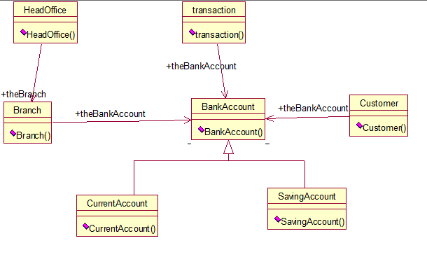
Class Diagram for Forward Engineering

Slide 4
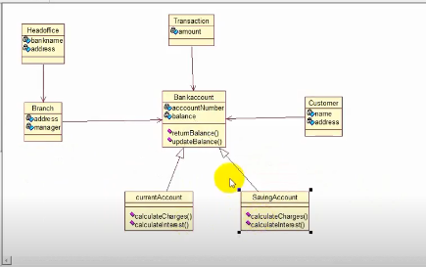
Class Diagram in Rational Rose after Reverse Engineering

Slide 5
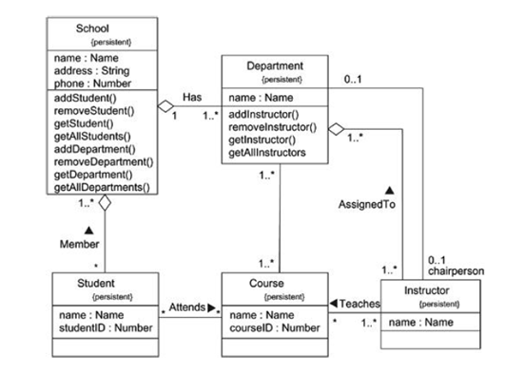
Example Class Diagram

Slide 6
How do you reverse engineer a class diagram?
Reverse engineer package diagram from source files
Select Tools > Code > Instant Reverse… from the toolbar.
In the Instant Reverse window, select Java as the Language.
Specify the path of the source file or the folder that contains those files.
Select Package Diagram for Reverse To:.
Click OK to start reversing.

Slide 7
Lab Tasks
Create class diagram of University Registration and School( shown in next slide) using that diagram apply concept of forward engineering in Rational Rose.
Apply concept of reverse engineering to create the class diagram using java code in Rational Rose for both diagrams given in next slide

Slide 8
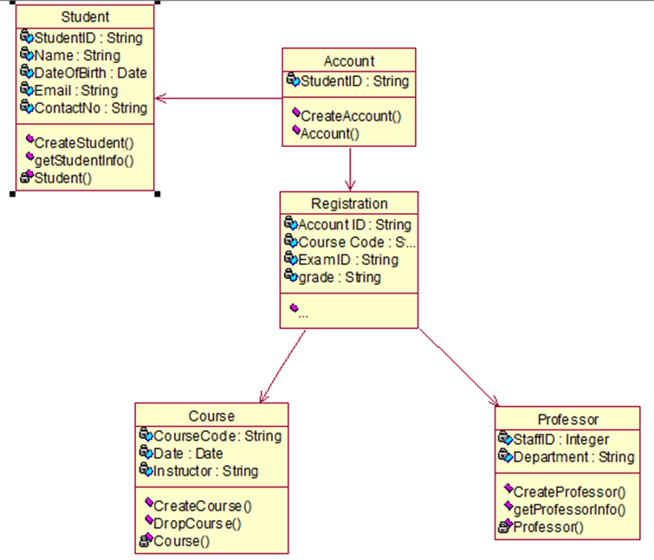
University Registration

Slide 9
School System

